Slide 1
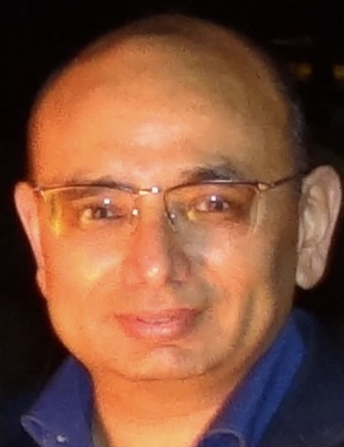


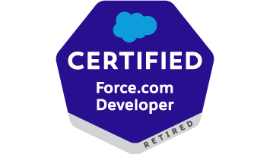


Vixit Bhardwaj – Technical Architect – Projects
5 x Salesforce Certified
Relevant Experience
Currently working as a Senior technical Architect for a leading Media and Technology client
Designed and developed the data model and end-to-end architecture ensuring that the data flows seamlessly between the related systems.
Designed and developed a Knowledge Base in the service cloud for community users which encompasses Trending Articles, Featured Topics and Favorite Articles, Configuring Experience Cloud, creating custom Lightning web components, designing user interfaces and integrating with external systems using the MuleSoft API’s
Responsible for of code review, Solution for Spaghetti Apex(duplicated and unbulkified logics), optimize the existing configurations
Work closely with client partners, technology data vendors and cross functional teams to design, develop, adopt, and manage modernization programs of client architecture and data quality management.
Write complex queries and perform data analysis, analyze application issues or process failures
Profile Summary
Detail oriented Architect with a 15 years of deep understanding and hands on with Salesforce platform, including its declarative and customization side
Designed 14+ Enterprise grade solutions on Sales/Service/Experience cloud.
Contributed to Complex design and technical Implementation with Fortune 500 companies & clients that drive operational efficiency and sales growth
Strong experience in integrating third-party systems using the Salesforce API
Handled large-scale data migrations without disrupting business processes
Transformed Legacy/Classic Salesforce Platform into 100% Lightning Systems.
Hands-on with Force.com platform technologies including Apex Class, Triggers, Lightning Flows, Lightning Aura and LWC components, Data modeling.
Implemented Salesforce Shield for encrypting PII data, Data Masking, Event Monitoring.
Other experiences
Analyze scope of work, Requirement gathering and working closely with onshore team and client.
Articulate business problems and participate in the development of conceptual and logical architecture
Identify all areas where improvement can be made ex: memory leakage, hard coding removal or coding standard were not followed.
Estimation for Jira stories and elaborate the stories on Jira.
Ensure on time delivery of modules as per committed timelines.
Expand all existing implementation including integration for new business and closely worked with other interface team to implement it.
Responsible for QA/UAT completion for all stories as per sprint plan and complete it on time along with issue resolution.
Technical and Functional Expertise
Security and Access Governance Management
Documentation and Knowledge Management
Governance and CoE Processes (manage prioritization and backlog grooming, define technical standards, naming conventions and flow guidelines)
Technical Debt Management
Project Estimations and implementation Strategy
Solution Design via JAD Session
Deployment Strategies and Change Management
Coaching & Mentoring

